Slide 1
The Voice of the Smart Energy Communities Marketplace in Canada
A Conversation about Community Climate Financing
Webinar| July 7, 2020
Notes:
Hello everyone, thank you for attending this webinar about Community Climate Financing. This webinar is part of the webinar series funded by FCM as part of the Communities of Practice Staff Grant Program.
My name is Emma Norton, I am Senior Lead, Stakeholder Relations at QUEST. I will be moderating today’s webinar.

Slide 2
Agenda
Introduction to QUEST
A brief overview of Funding & Financing Mechanisms and Tools for Community Climate Planning
QUEST’s Economic Impact of New Brunswick Community Energy Plans Report and Workbook
Town of Bridgewater, NS: Climate Financing and Stakeholder Engagement
Notes:
This webinar is part of the Communities of Practice Staff Grant Program - funded by FCM

Slide 3
Introductions
and
QUEST Overview

Slide 4
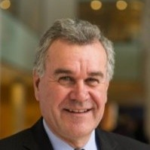
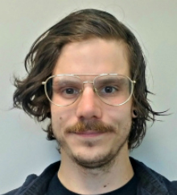
Speakers
Aida Nciri
Manager, Policy and Research
QUEST
Rob Kerr
Senior Associate
QUEST
Greg Goubko
Energy Finance and Development Coordinator
Town of Bridgewater
Notes:
Aïda is QUEST’s as Manager of Policy and Research. Passionate about low-carbon and resilient energy systems, Aida is based in Calgary, Alberta, where she manages and delivers projects advancing Smart Energy Communities in Canada. With over seven years of research and consulting experience, Aïda brings a sound interdisciplinary expertise in energy systems, urban governance, and climate and energy policies. She has worked with non-profits, academic institutions, and institutional agencies including Energy Efficiency Alberta. Bilingual in French and English, Aïda holds a Master Degree of Public Policies from Sciences-Po Paris (France) and a PhD degree from the University of Calgary. Her research analysed the construction of energy and climate policies developed by the three levels of government and their impact on the diffusion of distributed generation, and more specifically on district energy systems.
Rob Kerr is currently an independent consultant, based in Guelph, Ontario, providing community energy services. Rob has over 35 years of experience in many facets of the transitioning energy market with a focus on policy development and implementation of energy and climate change projects/programs in the municipal and community space.
Rob’s work experience has been a balance between the private and public sector, having worked with the cities of Guelph and Mississauga, Honeywell, Hydro Quebec, Toronto Hydro Energy Services Inc., and Energy Advantage. Rob has held senior positions at ICLEI – Local Governments for Sustainability providing policy and program support to cities around the world committed to climate mitigation and adaptation activities. He has developed expertise in managing inter-governmental relationships – from his advocacy work at the global level (starting with the UN Climate Conference in Kyoto, Japan in 1997) – to ongoing advisory relationships with the Canadian federal and provincial governments as well as the Federation of Canadian Municipalities.
Rob works with QUEST as a Senior Associate to further the development of Smart Energy Communities and the implementation of Community Energy Planning through policy support.
Greg Goubko is the Energy Finance and Development Coordinator for the Town of Bridgewater here in NS. He was a core team member in the development of the Town’s Energy Poverty Reduction Program, which in May 2019 was announced as the winner of Infrastructure Canada’s $5 million Smart Cities Challenge competition. His focus is on developing a capitalization system which recycles investment-returns and energy savings back into the local economy as part of the Town’s clean energy transition. In his spare time, you can catch him walking 2 lovely doggos, reading Hesse at a coffee shop, or bouncing to live music with his partner.
I’m sure you’ll have lots of questions for this knowledgeable group today. Please type your questions into the chat and we’ll save them until the end.

Slide 5
About QUEST
Vision
Canada is a nation of Smart Energy Communities
Mission
To accelerate the adoption of efficient and integrated community-scale energy systems in Canada by informing, inspiring, and connecting decision-makers
Purpose
To build a more sustainable energy future for Canada by empowering Smart Energy Communities
Notes:
For those of you who don’t know QUEST, we are a neutral, non-partisan, and business friendly non-profit service organization and we have a vision that is local - in fact it is as local as it gets.
Because while large, energy infrastructure projects still steal the headlines, the really exciting story is unfolding right here, down on Mainstreet.
Its yielding stronger local economies, lower energy costs for citizens and corporations, improved resilience and security - and, almost as a happy accident, cleaner air, land and water.
I’m of course talking about Smart Energy Communities.
A concept that grounds QUEST and is the ideal end-state of our work.

Slide 6
What is a Smart Energy Community?
A Smart Energy Community is one that:
Understands the compelling challenge of climate change
Recognizes the reality of community energy needs and priorities
Integrates local, renewable, and conventional energy sources
Efficiently, cleanly, safely, and affordably meets its energy needs
Smart Energy Communities are an essential foundation for
effective energy and climate policy

Slide 7
QUEST’s Offerings
Working Groups
A place for our Subscribers to collaborate, learn from one another, influence policy directions, and evaluate how to implement on-the-ground solutions
Research & Tools
Projects and research that empowers practitioners and decision makers with the tools they need to advance Smart Energy Communities
Advisory Services
A suite of trusted and independent services built out of our experience that help accelerate the implementation of Smart Energy Communities
Events
Working with partner organizations, curating Smart Energy Community panels and working sessions at leading energy, environment, and technology focused events across Canada
Notes:
Again, this webinar is part of the webinar series funded by FCM as part of the Communities of Practice Staff Grant Program.
A reminder to type your questions into the chat and we’ll get to them at the end.

Slide 8
A brief overview of Funding & Financing Mechanisms and Tools for Community Climate Planning
Aida Nciri

Slide 9
BIG Warning….
There is NO silver bullet...
… but there are strategies and tactics...

Slide 10
Strategies and tactics
Check the handout.

Slide 11
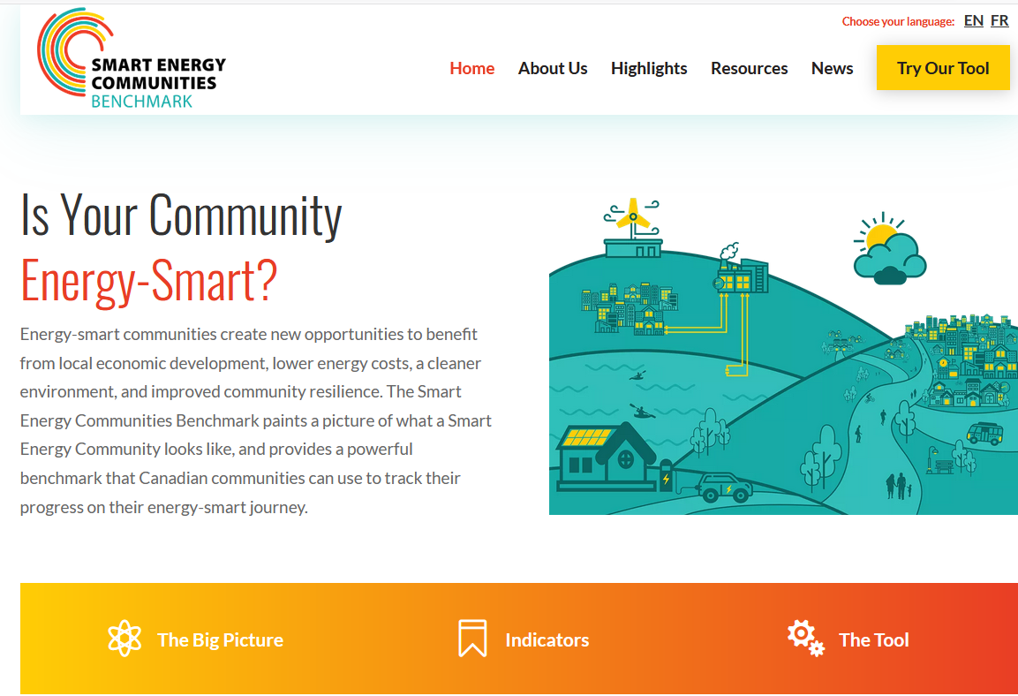
SEC Benchmark
A governance tool that provides guidance on how to implement and monitor Smart Energy Communities.
Financials is one of the ten indicators. The tool identifies tailored financing programs you can implement in your community.
Visit: https://smartenergycommunities.ca/

Slide 12
QUEST’s Economic Impact of New Brunswick Community Energy Plans Report and Workbook
Rob Kerr

Slide 13
Town of Bridgewater, NS: Climate Financing and Stakeholder Engagement
Greg Goubko

Slide 14
Climate Financing and Stakeholder Engagement
Notes:
We haven’t yet deployed our investment system, but I hope to showcase the principles and values that will bring hundreds of millions of $ into our community to support a replicable clean energy transition with a focus of first helping those most vulnerable to increasing energy prices.

Slide 15
Agenda
Objectives (It may get philosophical!)
Energize Bridgewater Project Overview
Investment System Architecture
Questions
Notes:
Community needs, values, opportunities,

Slide 16
Intro and Objectives
Break Down Silos and Share Resources
Bottom Up Over Top Down
Look at Yourself! What have you absorbed? Who invested in you?
Themes: Engagement | Shared Resources and Responsibilities | Community
Notes:
Objectives might be a little philosophical, but please bare with me, we will spend some time on the tangible financing mechanics where I’ll highlight the importance of stakeholder relationship: Convey how principles of shared resources and a ground level community approach translate to investment system efficacy.
How do we break down silos and share resources in a world that is accustomed to proprietary development (especially when money is involved) and how do we transfer the personal gains of some to the community gains of many?
We’re hoping our financing scheme will showcase how effective a project can be when developed with multiple partners (community members, businesses, fin-tech leaders, etc.).
To demonstrate the power of a bottom up, open book approach lets first look at ourselves and our personal life experiences. I think the lessons leaned here translates to any system or concept being designed.
So think about your own lived experiences here. How did you absorb information and who invested in you, to get you where you are today?
I’ll walk you through my experiences.
Worked in a number of completely different industries with entirely different people: Residential Cleaners (50% of the workforce were Chilin or Brazilian), Lab Technician (50% Romanian) , Community Investment Manager (multi-cultural environment)
Lab: Learned the importance of diligence (people’s lives depended on meticulous calibrating and testing). Bulgarian proverbs that stuck with me
Res Cleaning: Really learned the importance of commutating with those you’re trying to help. If we spent 3hours doing a meticulous job on ceiling fans, but the client wanted spotless floors.. Well that wouldn’t be good.
RE Co-op: Communities are interested and take pride in owning and/or investing in local projects.
Personally, one of my great friends in Toronto was indigenous fashion designer - > I learned a lot a valuable lessons on appropriation and connections with nature, and understand that you’ll never understand a person or culture if you don’t have the lived experience.
Who invested in me? Well, people close to me -> co-workers, fiends, family. (My individual community)
Absorbing skills and values helped me grow as a person and professional.
All through information sharing -Learning from professionals and experiences. And being invested in (at a community level)
What would your life be like if no one shared information with you and you were left to learn on your own. And if those who surround you hadn't invested in you - You’d probably be in a much different place.
This philosophy of absorbing information for one’s betterment and being invested-in from those close to you, works on a micro (personal) level, and I’ll now show how our clean energy projects can and will be financed through the same principles (information sharing and community investments). Through this I hope to convey a fin system is only as successful as the values, principles and people who contributed to its development.

Slide 17
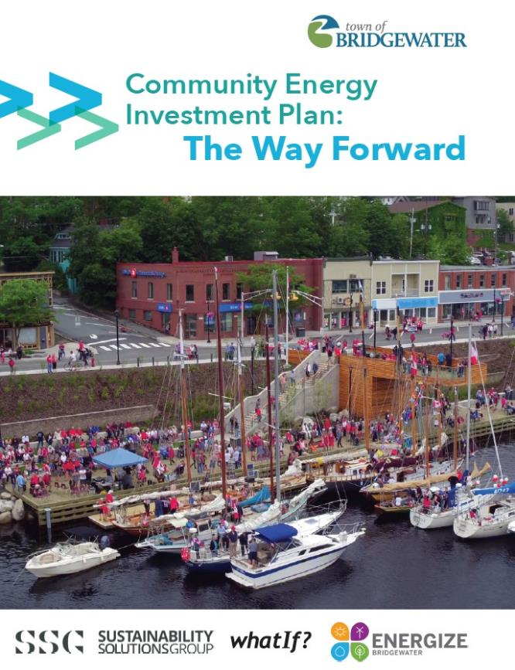
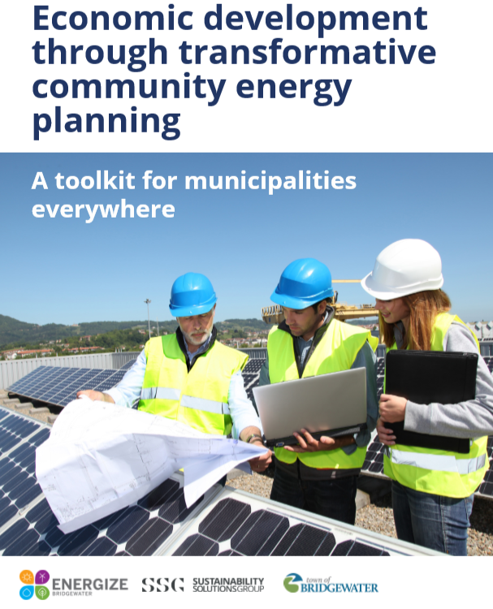
Project Overview
Notes:
Before jumping into the investment design and mechanics, I’ll run you though a quick synopsis of our energy projects, and how it evolved through the identification of an imminent community need.
In early 2018, we released the CEIP which modelled the technical strategies, costs, returns, and outcomes, to achieve an 80% reduction in GHG emissions by 2050.
These tech starts were Clean and Active Transportation – Neighborhood retrofits – and Community Scale renewable energy systems.
Tying this back to info sharing:
It’s important to note that wherever possible, we intend to publish and make our resources public – so that other communities can use our findings as a toolkit to develop their own transition – as a society, this will breakdown silos and ultimately make the transition more efficient. Be it an energy transition, poverty reduction transition, arts transition, etc. (not strictly financing!)

Slide 18
Project Overview
Project Evolution
Bridgewater’s annual expenditure on energy. The large majority of that money leaves the community… and the province.
$6500
The average annual cost of energy for Bridgewater residents to heat and power their home (electricity, fuel oil, propane, firewood, etc.), and buy fuel for transportation (diesel, gasoline)
$88 M
‹#›
Notes:
The project evolved through the collection of data which highlighted an imminent community need.
We learned that TOB residents were, on average, spending 6500 / year on energy, and when compared to resident income, we estimated that That’s nearly 2 in 5 residents suffer live in EP -> Making a trade off between heating homes and putting food on the table (spending over 10% of net income on energy)
Also learned that nearly 90M leaves the TOB economy each year to fulfill the Town’s energy needs. What would happen if that money was kept in the community and recycled.

Slide 19
Lived Experience of Energy Poverty
38.5% of Bridgewater residents experience energy poverty
Social
Living in energy poverty makes individuals more isolated, unable to leave their home, or engage in social relationships
Economic
High energy and housing costs forces individuals into trade-off decisions for basic necessities.
Health
Physical health is impacted due to cold, unsafe living environments.
Mental health is impacted by increased stress, depression, and anxiety from high energy bills
Notes:
To really understand the issue of Energy poverty the Town embarked in a robust SE exercise, to determine the need , and how we can measure successes (1-1, focus groups, census style survey).
As we raise funds to bring people out of energy poverty, it’s important to continually engage the community to recalibrate and pivot our program as needed (are people healthier, are they better off from a economic and social perspective, etc.)
Impacts of energy poverty are quite wide – they affect peoples social wellbeing
Important Take Away, from a financing perspective : There's a need and there are returns (some, like energy savings, easier to measure than say $ saved on healthcare). This is important: Impact investors do expect a return, but ultimately are driven by the triple bottom line -> Social and environmental benefits are greatly more important to them then accrued interest.

Slide 20
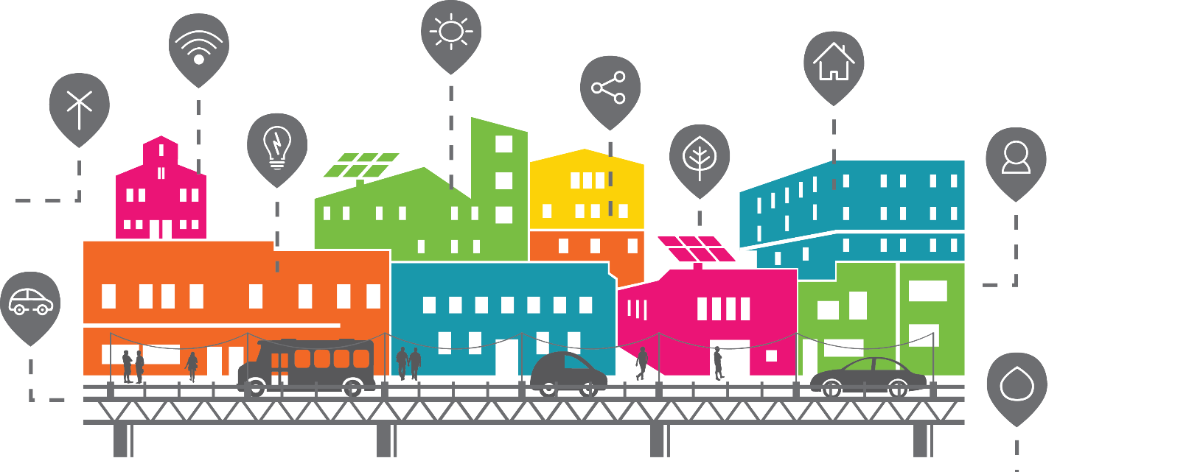
Bridgewater’s Smart Cities Challenge
Our community will lift its residents out of energy poverty, starting by reducing the energy poverty rate by 20% by 2025
‹#›
Notes:
Enter our SCC application to IC– an energy poverty reduction program
Our challenge statement:
Awarded $5M to design and deploy the program
Highlight that our statement suggests it involves a community effort -> it’s not the “town will” it’s the community will. Again, going back to that theme of shared resources and responsibilities. -

Slide 21
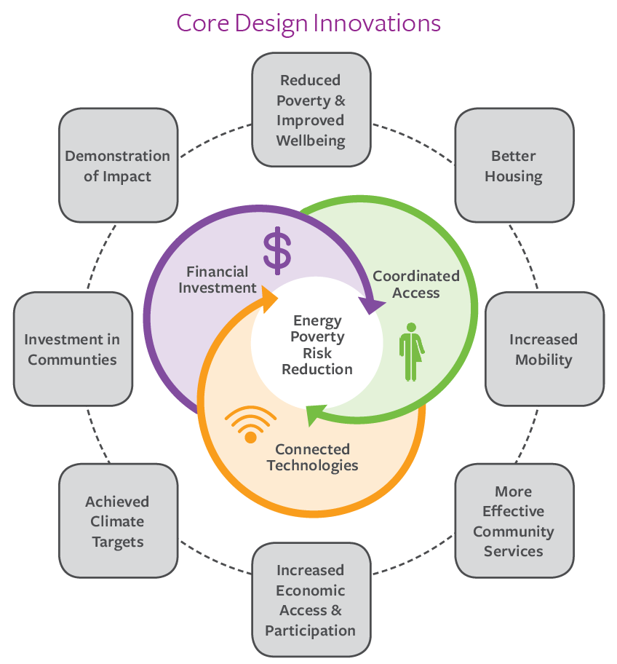
‹#›
Notes:
The plan we produced demonstrates the broad range of benefits – from increased mobility, better housing, climate targets.
These are catalysed through coordinated access, connected technologies and financial investments.

Slide 22
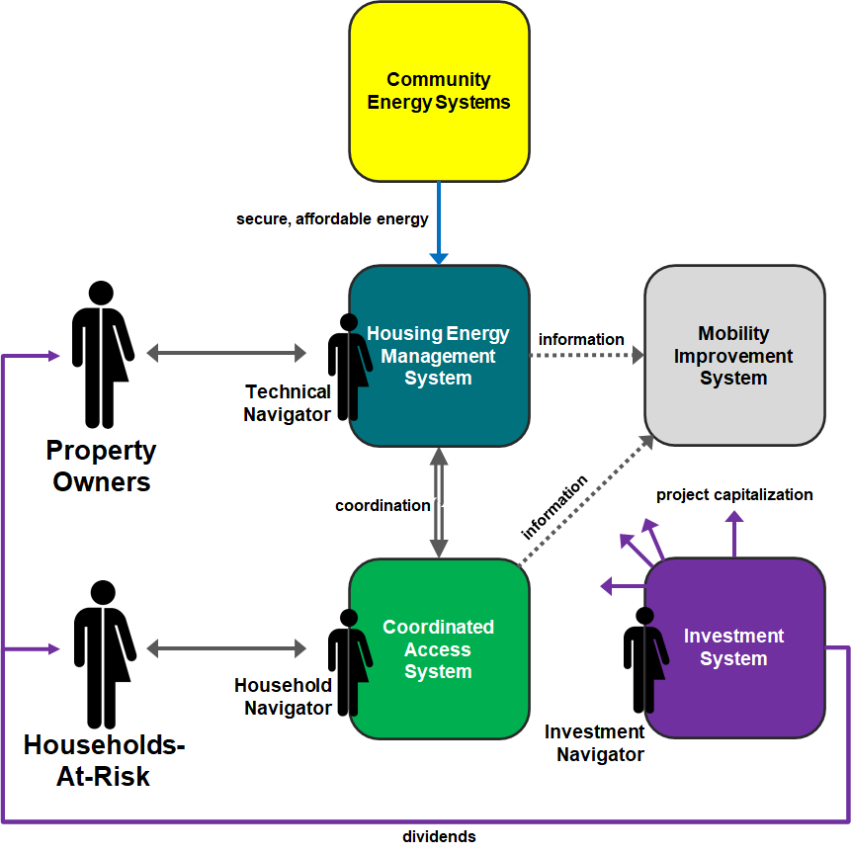
How the program will work?
Shared Responsibilities and Resources!
Notes:
Wont go through in detail
But important to note there are many interconnected systems at play all connected by data technologies, which allows us to track indicators and pivot operations as necessary :
Coordinated access – acts as a one stop shop for services, mental health income assistance, and energy poverty assistance. Important to work close with community service orgs, who offer amazing hands-on services to at risk community members. With more coordination and a sharing of resources, we anticipate streamlined services.
There's a MIS
HEMS – Is the heart of the program, where the actual home improvements take place through shared and coordinated resources (ENS, HNS, CMHC, …), which is supported by a CES. Where again we hope to share responsibilities and successes with partner (neighbouring MEUs, the utility, the province) -> We cant do this alone!
Now we’ll zoom into the IS where the themes of Engagement | Shared Resources and Responsibilities | Community really shine.

Slide 23
Investment System Early Concept
Early Design Stakeholder Engagement: Energy & Finance Working Group
‹#›
Notes:
This is the concept that was pitched to IC
Built on the idea of a bottom up approach to financing rather than a top down -> To truly be a community project it needs to be broader than a municipally capitalized project.
Relies on to separate but connected systems to source different forms of investments (not dependent on a single stream of capital).
Stakeholder engagement was of obvious importance in pulling together a smart-cities winning design: For the development of the concepts, through to implementation and operations, the Town pulled together a diverse group of stakeholders to absorb knowledge (pro bobo services | meeting 1-1 / adhoc)
(1) Local EE utility, Finance experts, lawyer, communications network specialist
Need to identify internal gaps and network to source
Will be expanding it to include indigenous rep, federal funding rep (i.e. CMHC) as examples.
Important to develop a “live’ terms of reference, to adapt to the changing need of the program (through concept, to deployment through to operations)

Slide 24
Municipal Capitalization System
Stakeholder Engagement: Stacking and Coordination Partners
‹#›
Notes:
Zooming in on the Municipal capitalization structure, we believe the Town is well positioned to funnel various forms of grant funding, subsidise, charitable donations (can issue charitable tax receipts), MFC funding (low interest).
This really is an exercise in Stacking existing resources and adding additional layers of financing. There’s already a number of great provincial programs that aim to retrofit housing stock in NS. Our program aims to coordinate what exists. Many of these incentive programs are already stacking (i.e. HNS, CNS, and ENS), but we’re exploring the coordination on a much larger scale -> Perhaps through an energy service company, which we’ll talk about shortly.

Slide 25
External Investment Vehicle
Overcomes Muni Limitations
Truly a Community Project
Participation
Ownership
Community Investments
Stakeholder Engagement: Foundations, Private, Co-ops, Organizational Experts, Service Delivery Agents
‹#›
Notes:
Now this is where designing the investment vehicle gets fun. For a number of reasons, municipalities alone can’t adequately capitalize clean-energy projects by itself.
So an external vehicle is needed to counter municipal restrictions (100% owners of financed projects, limitations on where we can borrow from –MFC). Makes it more of a community project (by allowing for participation, ownership empowerment, community investments)
Co-op: Allows for community participation
Gifting Membership shares to program participants – Empowers the vulnerable demographic we’re trying to assist though our program.
Community investments – allows community members to invest in local projects -> Keeps returns local
CEDIF: ETC attached to the investments where by 35% of investments are reimbursed in year 1, 20% in year 5 and 10% in year 10.

Slide 26
Deep pocket investors are great, but so are…
Utility, Regulatory, and Government
Financial Service Delivery Agents and Support
Trailblazers:
Original CEDIFs, Private Suppliers
Community: Residents, Property Owners, Indigenous
Notes:
Utility, Regulatory, and Government
AREA – a conglomerate of MEUs -> Developing solar and wind projects -> What can we learn from them, what can we share (in terms of resources, studies, etc.)
NS MEUs
ENS (Non profit energy utility) mandate to improve EE -> how can we have them pilot concepts in TOB
NS DoEM -> Gate keepers of policy -> how can we enable virtual net metering or a PPAs
NS Securities Commission - > Lobby to support for changes to tax credits
NS Dept. of Finance -
MS Dept. of Envr
FCM
NRCan
Infra Can
Neighbouring munis
Our own government -> Took the championing of a handful of dedicated council members and Leon de Vrede who started networking and creating a community push for a clean energy revolution on a local scale.
Financial Service Delivery:
SVX – Stock exchange for triple bottom line offerings
Tapestry Community Capital or Co-Power-> Back end and front end support
Vancity / Verge Capital / MaRS -> Share resources (and investors!)
Trailblazers:
New Dawn -> a charitable org turned CEDIF parent company – What can we learn from them, what can we hand off (grow their business and ours).
Innovation in technology: Comprehensive vendor database – flagging stand out technologies, discussing with partners (opportunities to pilot? Use ToB as a testbed for innovation).
Local Climate Banks - Is a global network of community-based financing entities
Current projects: Kenya and Guelph, ON
- Local “banks”, operating within confines of jurisdiction, whose mandate is to raise community investments while benefiting from a supporting global network
Glocal: Tapping international shared and open resources - using local tools (i.e CEDIF)
Community - Interested in investing? What turn-key value propositions work,
Property owners – What works for them, what doesn’t
Indigenous groups – There's so much to learn form indigenous groups. From sharing, to respect, to building community. These values can, and should be explored early on when developing any system, be it financial, technical, educational.
Obviously, we’re just scratching the service here, but the takeaway is that there are groups willing to support great causes - just a matter of getting that snow ball started. The more participants, the more resilient an investment system becomes. And by exploring all options, you be able to decipher what works and what doesn’t for your specific needs.
That great thing about this emerging investment realm is that everyone is willing to help one another – often missing in more traditional forms (stock exchange) of financing. Because the project need and solution are more important than the $ bottom line for all our partners.

Slide 27
Notes:
Stress the importance of marketing here:
It’s not shady sales, it’s pitching your offering with passion – You need to paint A VIBRANT PICTURE OF YOUR PROJECT
What would inspire someone to invest in your project?
Elevator Pitch - verbal
Communication Tools for information and follow-up
Really spend time on your elevator pitch -> people you begin to pitch to their networks, with their own personal and passionate spin -> If you let your passion show, money will flow!
What is the big potential of your business?
What are your potential investors interested in?
What will make them care?
What’s in it for them?
Be consistent
Be authentic
Be professional
Be persistent
Keep it simple and relatable
Establish your credibility
Create a sense of urgency!

Slide 28
Notes:
I won’t spend too much time here, but here is A ESCO business model -> Again, marketing and outreach is important for participant onboarding -> and in a nutshell Bridgewater community members receive home improvements with no upfront costs and a streamlined turn key process. Although residential ESCos are a novelty, it’s picking up a lot of momentum, and we believe that consolidating savings across neighbourhoods may be the solotion. The idea here is to stack standard esco services with other financing and funding streams (Like CEDIFSs) in one turn-key financing package.
It takes a lot of coordination -> but there is so much siloed momentum, we just need to start breaking down those silos, and share resources and learned experiences.

Slide 29
Questions? Greg Goubko Energy Finance and Development Coordinator Town of Bridgewater greg.goubko@bridgewater.ca 647-381-4425
Notes:
Bringing System Mapping to Life in Bridgewater
Where we Excel
Areas We Can Build On
How Coordinated Access Can Support Our Efforts

Slide 30
THANK YOU
Greg Goubko
Energy Finance and Development Coordinator
Town of Bridgewater
greg.goubko@bridgewater.ca
647-381-4425
Rob Kerr
Senior Advisor, QUEST
rob@rkerrassociates.ca
Aida Nciri
Manager, Policy and Research, QUEST
anciri@questcanada.org
Emma Norton
Senior Lead, Stakeholder Relations, QUEST
enorton@questcanada.org

